Slide 1

Cyber Security Challenges and Competitions
Module 6

Slide 2
Learning Objectives
To understand and appreciate the relevance of cyber security challenges and competitions
To learn how to create and conduct cyber security competitions

Slide 3
Topic Outline
Developing competition rules
Training modules
Virtualization
Building operating system images
Creating challenges and solutions
Designing a scoring system
Conducting an online competition
Finding resources

Slide 4
Basic Competition Rules
No interference
No denial of service
No tampering of servers
No sharing of keys
No sharing of hints
No outside help

Slide 5
Develop Training Modules
Trivia
Steganography
Password Cracking
Encryption
Encoded Message
Image/Picture Masking
Document Manipulation
Network Reconnaissance

Slide 6
Trivia (100)
http://www.gosoapbox.com
Event code: 288095730
Name the first computer programmer?
Mark Zuckerberg
Ada Lovelace
Bill Gates
Steve Jobs

Slide 7
http://www.gosoapbox.com
Event code: 288095730
Trivia (200)
When you log into a computer, it is a good practice
to do so as a regular user instead of an administrator.
This practice protects the system from increased harm if there is a virus present. This practice belongs to which principle?
Least privilege
Modularity
Resource encapsulation
Information hiding

Slide 8
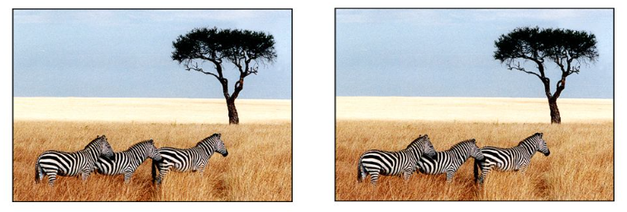
Steganography (100)
Which one has the complete text of 5 Shakespeare plays (Hamlet, Macbeth, Julius Caesar, Merchant of Venice, and King Lear) ?

Slide 9
Encoded Message (300)
http://www.gosoapbox.com
Event code: 288095730
Some weird looking message was received.
Who owns the following:
cha’ pagh vagh wa’ Soch loS
loS chorgh wa’ pagh pagh
Please help in deciphering the message.
Looks like it belongs to a friendly place in the South!
Whatismyipaddress.com may be able to help.

Slide 10
Encoded Message (300)
205 174 48 100
cha’ pagh vagh wa’ Soch loS
loS chorgh wa’ pagh pagh
Notes:
Use nslookup to search the IP address or use whatismyipaddress.com

Slide 11
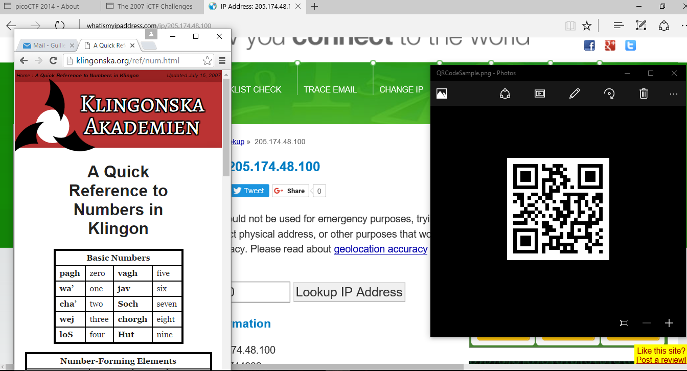
Image/Picture Masking (100)
http://www.gosoapbox.com
Event code: 288095730
What is the secret message behind this image?

Slide 12
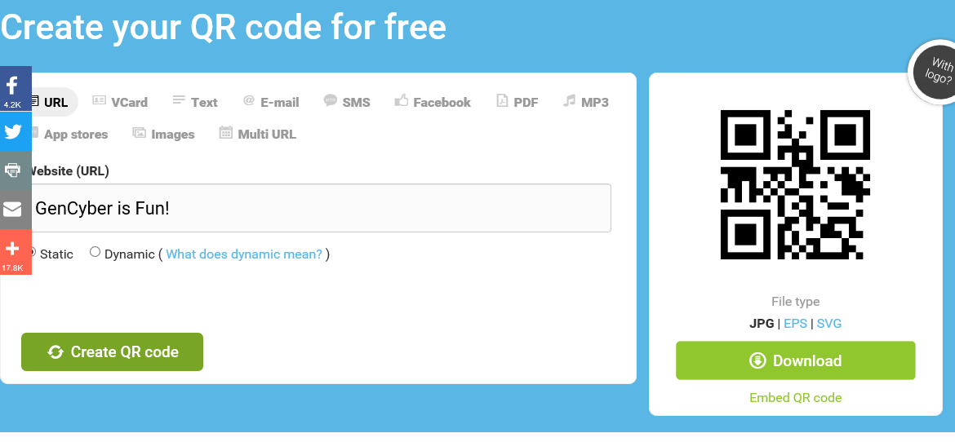
Image/Picture Masking (100)
Create an instant QR code at http://www.qr-code-generator.com/

Slide 13
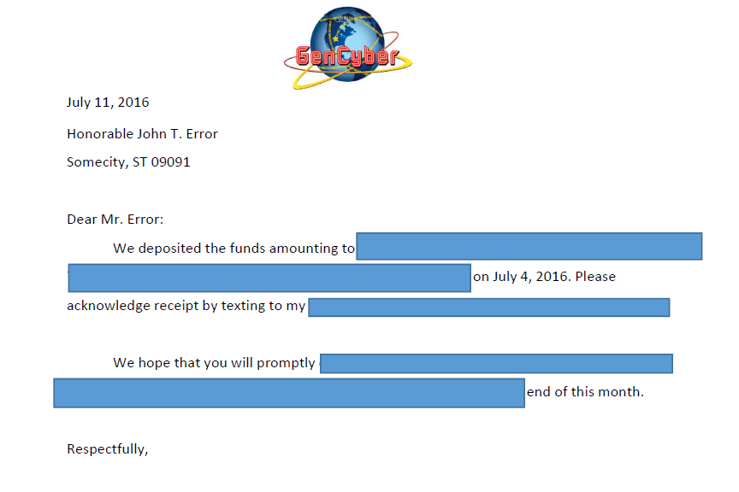
Document Manipulation (200)

Slide 14

Every Nook and Cranny (200)

Slide 15
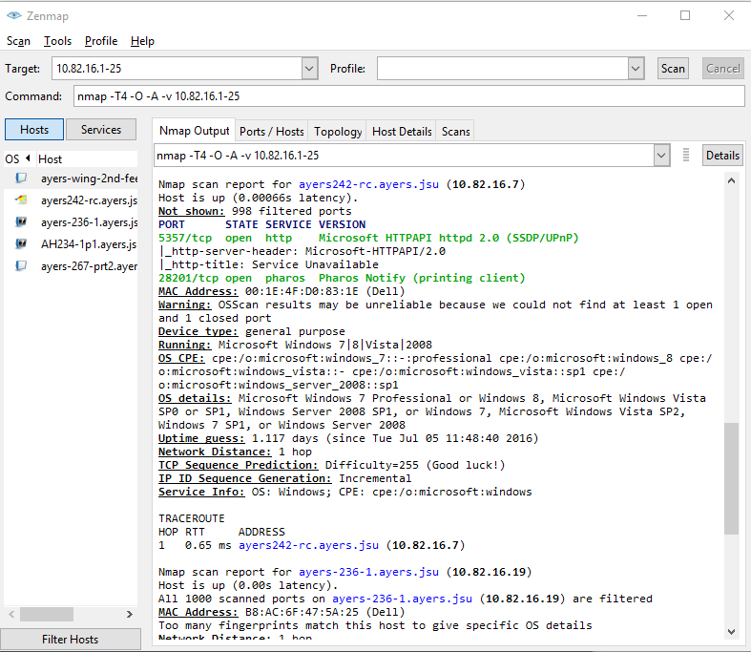
Network Reconnaissance

Slide 16
Network Command Cheat Sheet
ping-check for connectivity
ping 10.20.0.51
nslookup-queries for IP address or hostname
nslookup www.jsu.edu
ipconfig/ifconfig-checks the network configuration (Windows/Unix)

Slide 17


Creating Challenges and Solutions
Don’t make it too easy ☺
Don’t make it too hard ☹
Provide useful hints
Show the tools

Slide 18
Challenge Categories
Trivia Challenges
Google is your friend!
Digital Forensics
good use of tools and steganography
Network Security
Packet capture and analysis

Slide 19
Challenge Categories
Reverse Engineering
Needs a good handle of C and assembly languages
Penetration Testing
Quite possible with available tools
System Reconnaissance
Network and system mapping

Slide 20
Scoring System
In each category:
Provide a set with 5 levels of difficulty
Easiest is worth 100
Hardest is worth 500
Points accumulate depending on the number of challenges solved

Slide 21
Check for Understanding 3
http://www.gosoapbox.com
Event code: 288095730
In designing a CTF scoring system, make sure that it is well understood and easily implementable. This practice belongs to which principle?
Least privilege
Simplicity
Resource encapsulation
Information hiding

Slide 22
Scoring System
Break ties by giving preference to the team with the most number of higher level challenges solved (e.g. a team that solved a 500 level challenge is preferred over a team that solved 5 of the100 level challenges). Other tie-breaking techniques may also be applied.

Slide 23
Check for Understanding 4
http://www.gosoapbox.com
Event code: 288095730
Tie-breaker for scoring system may include:
time to capture
penalty points for incorrect submission
penalty points for rule violation
all of the above

Slide 24
Virtualization
A piece of software called the virtual machine monitor layer (e.g.Vmware or Virtualbox) sits directly on top of the hardware and provides an abstraction for the operating system. The operating system treats the VM as if it were a hardware itself.
Examples: Oracle Virtual Box, Vmware VSphere, Microsoft Hyper-V

Slide 25
Check for Understanding 5
http://www.gosoapbox.com
Event code: 288095730
The scheme in which the virtual system sits
on top of the host operating system to
enable additional hardware utilization is an example of which principle?
Abstraction
Domain separation
Least privilege
Simplicity

Slide 26
Main Virtualization Systems
Oracle™ Virtual Box
Device virtualization is through a virtual disk image (vdi)
Vmware™ Vsphere
Device virtualization is through virtual machine disk (vmdk)
Microsoft™ Hyper-V
Device virtualization is through virtual hard disk (vhd)

Slide 27

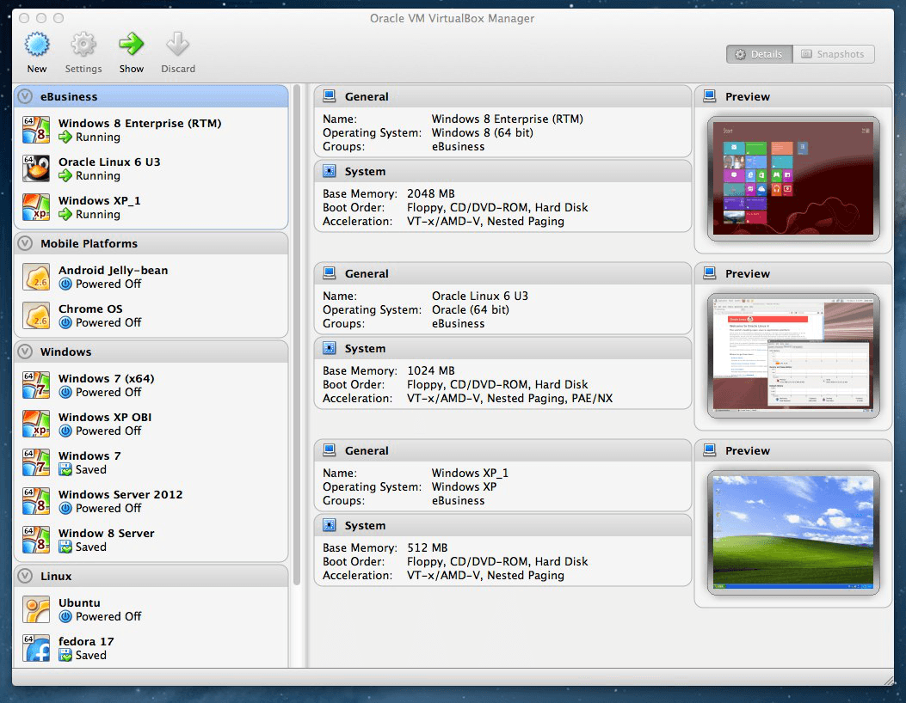
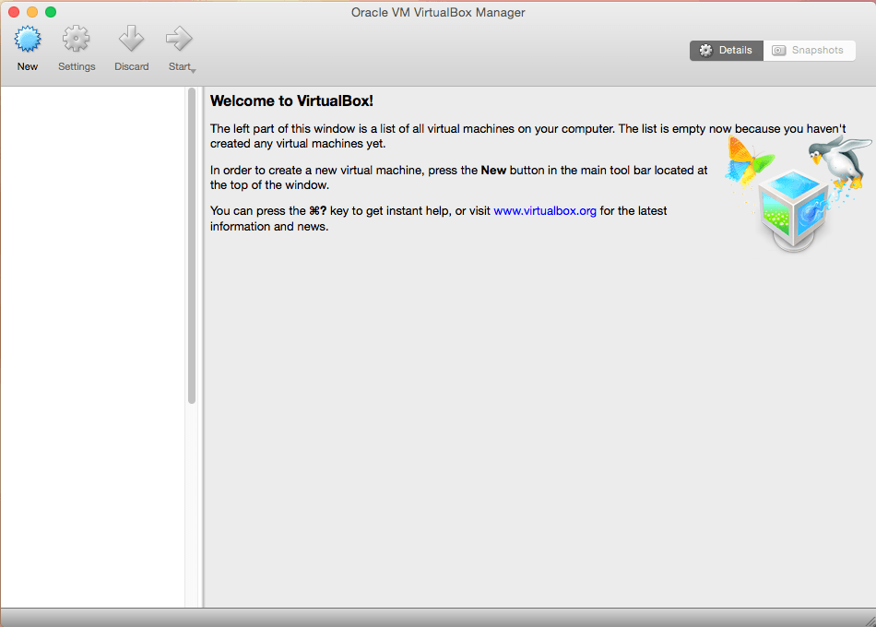
Creating VM on Virtual Box
Virtual Box Manager

Slide 28
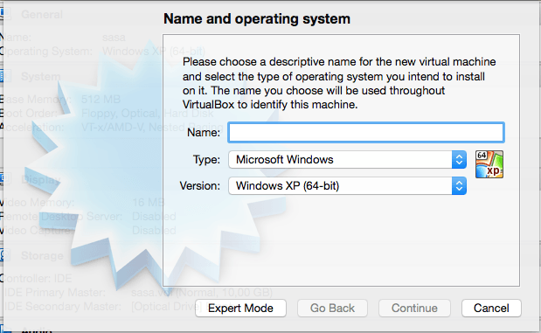
Creating VM on Virtual Box
On the Virtual Box Manager menu, click on”New”

Slide 29
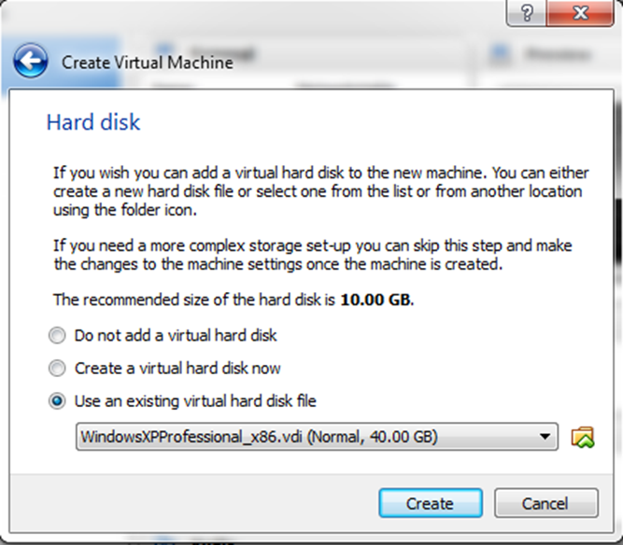
Creating VM on Virtual Box
Specify a Virtual Hard Disk for your VM

Slide 30
Starting VM for the First Time
The "First Start Wizard" will pop up to help you
select an installation medium.
If installing from a medium (CD-ROM, etc.),
insert the medium in the drive and select “Host Drive”
If installing from an ISO image, bring up a
standard file dialog and select the ISO image file.
Note: Capturing the mouse and the keyboard requires
clicking on the VM window. Releasing requires
pressing the Host Key (right CTRL key)

Slide 31
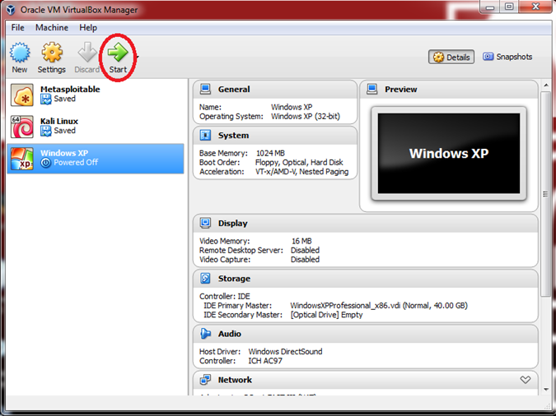
Starting VM on Virtual Box

Slide 32
Check for Understanding 6
http://www.gosoapbox.com
Event code: 288095730
Running multiple virtual machines without interfering each other is a result of which principle?
Simplicity
Least privilege
Process isolation
Abstraction

Slide 33
Finding Resources
National Cyber League (http://nationalcyberleague.org/index.shtml). Provides an online virtual training facility using team gaming concepts.
CyberPatriot (http://www.uscyberpatriot.org/home). CyberPatriot is the National Youth Cyber Education Program that has three distinct programs: the National Youth Cyber Defense Competition, AFA CyberCamps and the Elementary School Cyber Education Initiative.
New York University Cyber Security Awareness Week (NYU-CSAW) Capture the Flag (https://csaw.engineering.nyu.edu/ctf). Capture the Flag (CTF) challenges are designed to enable contestants to integrate concepts, develop skills and learn to hack as they progress in the competition.
PicoCTF (https://picoctf.com). picoCTF is a computer security game for middle and high school students. It consists of a series of challenges where participants must reverse engineer, break, hack, decrypt, or do whatever it takes to solve the challenge.

Slide 34
Finding Resources
Other online resources include the following:
Smash the Stack (http://smashthestack.org/) Challenging online exploitation exercises.
Crackmes.de (http://crackmes.de/) Reverse engineering challenges.
Netforce.nl (https://www.net-force.nl/) web exploitation and cryptography).
Cybrary (https://www.cybrary.it/) Open source security training.

Slide 35

QUESTIONS

